Slide 1
SQL Server High Availability
For Virtualized and Cloud Deployments

Slide 2

About Me
John Q Martin
Solutions Engineer – SQL Sentry
Twitter : @SQLDiplomat
Email : jmartin@sqlsentry.com
Blog : http://blogs.sqlsentry.com/author/JohnMartin
Over a decade of experience with SQL Server
DBA
Dev
BI
Worked for Microsoft as a Premier Field Engineer (PFE) in the UK

Slide 5
Agenda
Cloud Providers
Core Concepts
High Level Architecture

Slide 6
Cloud Providers
Microsoft
Amazon
Rackspace

Slide 7
Core Concepts
Segregation of resources
Modular systems
Environmental Restrictions

Slide 8
Microsoft Azure
Region
Resource Group
Availability Set
Fault Domain
Update Domain

Slide 9
Amazon AWS
Region
Availability Zone

Slide 10
Rackspace
Region
Compute Cell
Availability Zone
Notes:
http://docs.openstack.org/arch-design/massively-scalable-technical-considerations.html

Slide 11
Virtualization
Data Centre
Racks
Clusters
Nodes

Slide 12
Cloud and Virtualization
Multiple VMs in Availability Set.
Use Availability Sets for each Tier.
Segregate Storage for the same service.
Fault Domain 0
Fault Domain 1

Slide 13
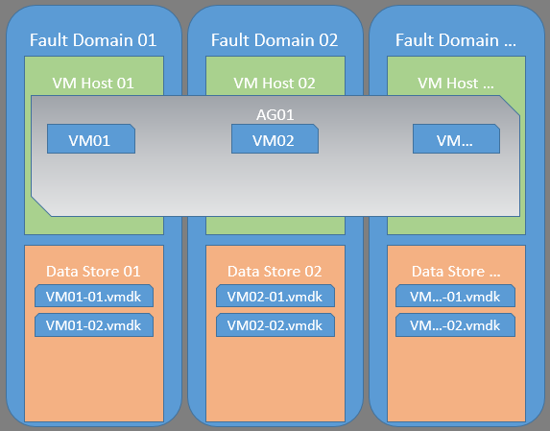
Cloud and Virtualization
Important to isolate components providing same service.
Leverage Anti-affinity.
Understand the concept of a Fault Domain.

Slide 14
Cloud and Virtualization
Limit the scope of potential impact.

Slide 15
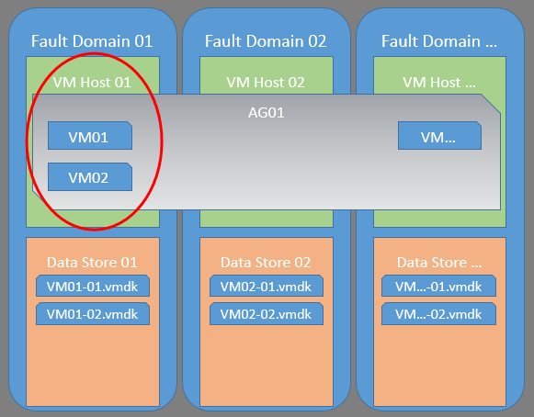
Cloud and Virtualization
Limit the scope of potential impact.
Understand placement of storage components.

Slide 16
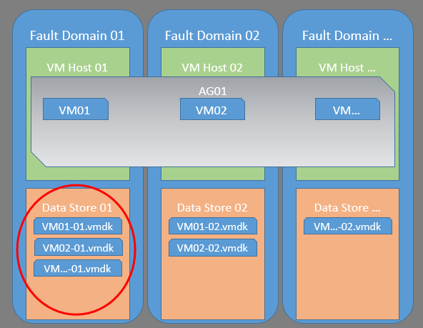
Cloud and Virtualization
Limit the scope of potential impact.
Understand placement of storage components.

Slide 17
Cloud and Virtualization
When using a public cloud offering, understand the requirements for SLA cover.
Azure has specific requirements
Important environment details.
Availability Sets
Fault Domains
Upgrade Domains

Slide 18

Questions

